Slide 1

PROBLEM STATEMENT: CCTV CAMERAS AND FACE RECOGNITION BY FILTERING
Problem –
No application is available which can automatically recognize a facial images in CCTV footage and compare it with the database photos of users to identify the person in real time.
In detail –
This application can recognize the face in CCTV footage and availability of this could be useful for searching or identifying a person in any organizations such as education and software sectors.

Slide 3

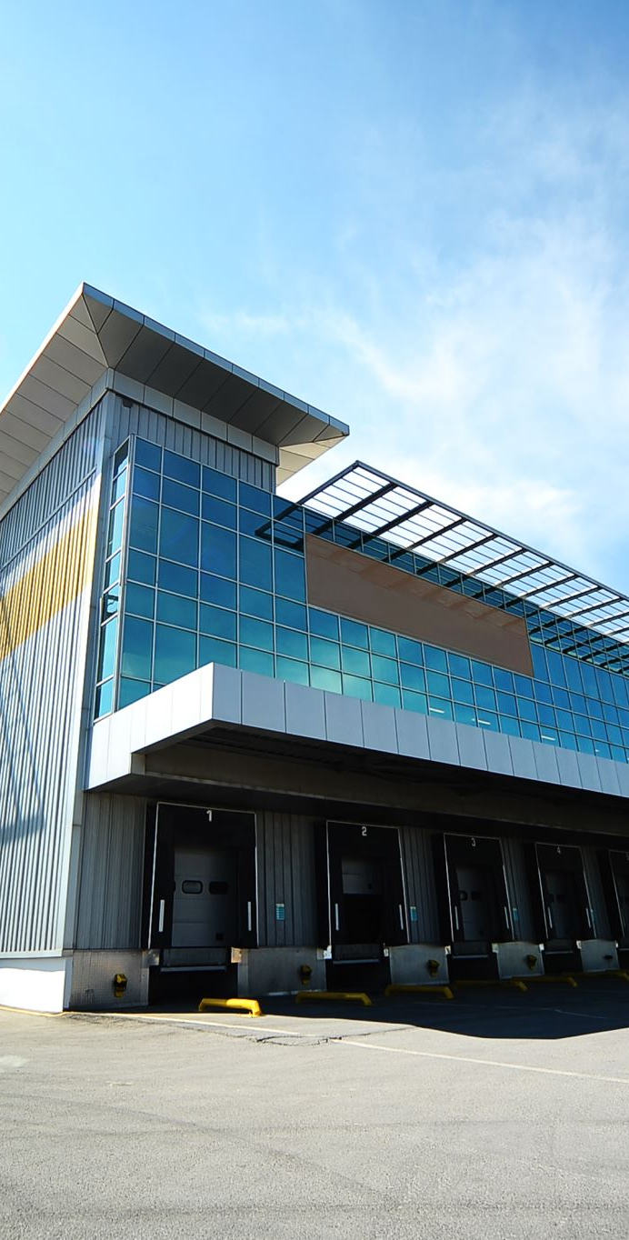
Example:
We will observe this situations in companies, institutions and welfare organisations.
For example:
To locate the position of staff in our premises who is not on his seat and required urgently at some place.

Slide 4

MODIFICATIONS
With existing process:
Currently, in order to recognize the face of a person they go through the complete video and recognize the person manually with the photos they have.
With our application:
It is used to recognize the photos from database in different possible forms(different angles of image ,features) in cctv footage automatically.

Slide 5


